Slide 1
Static Testing
Software Testing
ISTQB / ISEB Foundation Exam Practice
Chapter 3
1 Principles
2 Lifecycle
3 Static testing
4 Dynamic test
techniques
5 Management
6 Tools

Slide 2
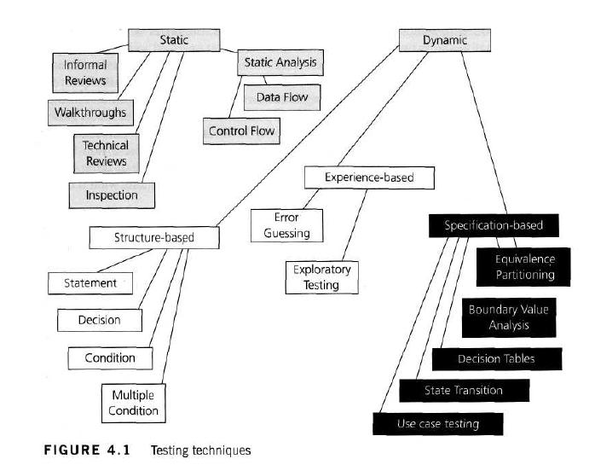

Slide 3
Contents
Reviews and the test process
  A review is a systematic examination of a document by one or more people with the main aim of finding and removing errors.
  Reviews can be used to test anything that is written or typed; this can include documents such as requirement specifications, system designs, code, test plans and test cases.
  Reviews represent the first form of testing that can take place during a software development life cycle, since the documents reviewed are normally ready long before the code has been written.
  The practice of testing specification documents by reviewing them early on in the life cycle helps to identify defects before they become part of the executable code, and so makes those defects cheaper and easier to remove.
Static analysis

Slide 4
Benefits of reviews
Development productivity improvement
Timescales reduced
  the correction of defects in early work-products will help to ensure that those work-products are clear and unambiguous.
Reduced testing time and cost
  By reviewing the code and removing defects before they become failures the tester can move more swiftly through test execution.
Lifetime cost reductions (support)
  fewer defects in the final software ensure that ongoing support costs will be lower.
Improved customer relations
  authors and their peers discuss and refine any ambiguous content discovered during review to ensure that all involved understand exactly what is being delivered.

Slide 5
The types of defects most typically found by reviews are
Deviations from standards
  either internally defined and managed or regulatory/legally defined by Parliament or perhaps a trade organisation.
Requirements defects
  for example, the requirements are ambiguous, or there are missing elements.
Design defects
  for example, the design does not match the requirements.
Insufficient maintainability
  for example, the code is too complex to maintain.
Incorrect interface specifications
  for example, the interface specification does not match the design or the receiving or sending interface.

Slide 6
Reviews are cost-effective
10 times reduction in faults reaching test, testing cost reduced by 50% to 80%
  Handbook of Walkthroughs, Inspections & Technical Reviews - Freedman & Weinberg
reduce faults by a factor of 10
  Structured Walkthroughs – Yourdon
25% reduction in schedules, remove 80% - 95% of faults at each stage,
  28 times reduction in maintenance cost, many others
  Software Inspection - Gilb & Graham

Slide 7
What can be Inspected?
Anything written down can be Inspected
policy, strategy, business plans, marketing or advertising material, contracts
system requirements, feasibility studies, acceptance test plans
test plans, test designs, test cases, test results
system designs, logical & physical
software code
user manuals, procedures, training material

Slide 8
What can be reviewed?
anything which could be Inspected
  i.e. anything written down
plans, visions, “big picture”, strategic directions, ideas
project progress
  work completed to schedule, etc.
“Should we develop this” marketing options

Slide 9
What to review / Inspect?
Tests
Requirements
Accept. Test
Tests
Functions
System Test
Tests
Design
Integration T
Tests
Code
Unit Test

Slide 10
Costs of reviews
Rough guide: 5%-15% of development effort
  half day a week is 10%

Slide 11
Reviews in general 1
Objectives / goals
  validation & verification against specifications & standards
  achieve consensus (excluding Inspection)
  process improvement (ideal, included in Inspection)

Slide 12
Reviews in general 2
Activities
  planning
  overview / kick-off meeting (optional)
  preparation / individual checking
  review meeting (not always)
  follow-up (for some types)
  metrics recording & analysis (Inspections and sometimes reviews)

Slide 13
Reviews in general 3
Roles and responsibilities
  Leader / moderator
    He or she determines, in co-operation with the author, the type of review, approach and the composition of the review team.
    The moderator performs the entry check and the follow-up on the rework.
    The moderator also
      schedules the meeting,
      disseminates documents before the meeting,
      coaches other team members,
      paces the meeting,
      leads possible discussions and
      stores the data that is collected.
  Author of the document being reviewed / Inspected
    the author's basic goal should be to learn as much as possible with regard to improving the quality of the document

Slide 14
Roles and responsibilities
  The scribe
    the scribe (or recorder) has to record each defect mentioned and any suggestions for process improvement
  Reviewers / Inspectors
    Specialised fault-finding roles for Inspection.
    The task of the reviewers (also called checkers or inspectors) is to check any material for defects, mostly prior to the meeting
  Managers
    decides on the execution of reviews,
    allocates time in project schedules and
    determines whether review process objectives have been met.

Slide 15
Reviews in general 4
Deliverables
  Changes (edits) in review product
  Change requests for source documents
  Process improvement suggestions
    to the review / Inspection process
    to the development process which produced the product just reviewed / Inspected
  Metrics (Inspection and some types of review)

Slide 16
Contents
Static testing
1
2
3
ISTQB / ISEB Foundation Exam Practice
4
5
6
Reviews and the test process
Types of review
Static analysis

Slide 17
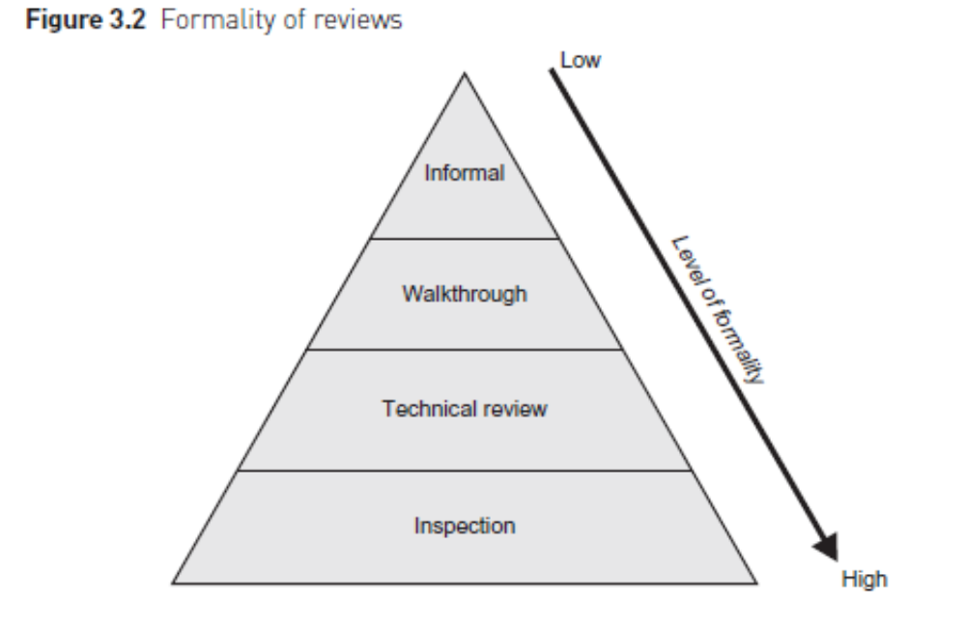
Types of review of documents
1- Informal Review (undocumented)
  There is no formal process underpinning the review.
  The review may be documented but this is not required.
Notes:
48

Slide 18
Types of review of documents
2- Walkthrough
The specific goals of a walkthrough depend on its role in the creation of the document. In general the following goals can be applicable:
  to present the document to stakeholders both within and outside the software discipline, in order to gather information regarding the topic under documentation;
  to explain (knowledge transfer) and evaluate the contents of the document;
  to establish a common understanding of the document;
  to examine and discuss the validity of proposed solutions and the viability of alternatives, establishing consensus.
Key characteristics of walkthroughs are:
  The meeting is led by the authors; often a separate scribe is present.
  Scenarios may be used to validate the content.
  Separate pre-meeting preparation for reviewers is optional.
Notes:
48

Slide 19
3- Technical Review:(or peer review)
The goals of a technical review are to:
  assess the value of technical concepts and alternatives in the product and project environment;
  establish consistency in the use and representation of technical concepts;
  ensure, at an early stage, that technical concepts are used correctly;
  inform participants of the technical content of the document.
Key characteristics of a technical review are:
  It is a documented defect-detection process that involves peers and technical experts.
  It is often performed as a peer review without management participation.
  Ideally it is led by a trained moderator, but possibly also by a technical expert.
  A separate preparation is carried out during which the product is examined and the defects are found.
  Use of checklists and a logging list or issue log are optional.

Slide 20
4- Inspection: (most formal)
The generally accepted goals of inspection are to:
  help the author to improve the quality of the document under inspection;
  remove defects efficiently, as early as possible;
  improve product quality, by producing documents with a higher level of quality;
  create a common understanding by exchanging information among the inspection participants;
  train new employees in the organization's development process;
  learn from defects found and improve processes in order to prevent recurrence of similar defects;
  sample a few pages or sections from a larger document in order to measure the typical quality of the document, leading to improved work by individuals in the future, and to process improvements.
Key characteristics of an inspection are:
  It is usually led by a trained moderator (certainly not by the author).
  It uses defined roles during the process.
  It involves peers to examine the product.
  Rules and checklists are used during the preparation phase.
  A separate preparation is carried out during which the product is examined and the defects are found.
  The defects found are documented in a logging list or issue log.
  A formal follow-up is carried out by the moderator applying exit criteria.
  Optionally, a causal analysis step is introduced to address process improvement issues and learn from the defects found.
  Metrics are gathered and analyzed to optimize the process.

Slide 21
Inspection is different from reviews
the document to be reviewed is given out in advance
typically dozens of pages to review
instructions are "please review this"
not just product, sources
chunk or sample
training, roles

Slide 22
Inspection is different
some people have time to look through it and make comments before the meeting (which is difficult to arrange)
the meeting often lasts for hours
entry criteria to meeting, may not be worth holding
2 max., often much shorter

Slide 23
Inspection is different
"I don't like this"
much discussion, some about technical approaches
don't really know if it was worthwhile, but we keep doing it
Rule violations, objective, not subjective
no discussion, highly focused
only do it if value is proven (continually)

Slide 24
Contents
Reviews and the test process
Types of review
Static analysis

Slide 25
What can static analysis do?
Remember: static techniques do not execute the code
A form of automated testing
  check for violations of standards
  check for things which may be a fault

Slide 26
Descended from compiler technology
  a compiler statically analyses code, and “knows” a lot about it,
    e.g. variable usage; finds syntax faults
  static analysis tools extend this knowledge
  can find
    unreachable code,
    undeclared variables,
    parameter type mis-matches,
    uncalled functions & procedures,
    array bound violations, etc.

Slide 27
Data flow analysis
This is the study of program variables
  variable defined* where a value is stored into it
  variable used where the stored value is accessed
x is defined, y and z are used
x = y + z
IF a > b THEN read(S)
a and b are used, S is defined
*defined should not be confused with declared

Slide 28
Data flow analysis faults
n := 0
read (x)
n := 1
while x > y do
begin
read (y)
write( n*y)
x := x - n
end
Data flow anomaly: n is
re-defined without being used
Data flow fault: y is used
before it has been defined
(first time around the loop)

Slide 29
Control flow analysis
Highlights:
  nodes not accessible from start node
  infinite loops
  multiple entry to loops
  whether code is well structured, i.e. reducible
  whether code conforms to a flowchart grammar
  cyclomatic complexity and other metrics

Slide 30
Unreachable code example
Macro definitions
(different for different platforms the code runs on)
Buffsize: 1000
Mailboxmax: 1000
IF Buffsize < Mailboxmax THEN
Error-Exit
ENDIF
Static Analysis finds the THEN clause unreachable, so will flag a fault

Slide 31
Cyclomatic complexity
cyclomatic complexity is a measure of the complexity of a flow graph
  (and therefore the code that the flow graph represents)
the more complex the flow graph, the greater the measure
it can most easily be calculated as:
  complexity = number of decisions + 1

Slide 32
Which flow graph is most complex?
What is the cyclomatic complexity?
1
2
3
5

Slide 33
Example control flow graph
init
do
Pseudo-code:
Result = 0
Right = 0
DO WHILE more Questions
IF Answer = Correct THEN
Right = Right + 1
ENDIF
END DO
Result = (Right / Questions)
IF Result > 60% THEN
Print "pass"
ELSE
Print "fail”
ENDIF
if
r=r+1
end
res
if
pass
fail
end

Slide 34
Other static metrics
lines of code (LOC)
operands & operators (Halstead’s metrics)
fan-in & fan-out
nesting levels
function calls
OO metrics: inheritance tree depth, number of methods, coupling & cohesion

Slide 35
Summary: Key Points
Reviews help to find faults in development and test documentation, and should be applied early
Types of review: informal, walkthrough, technical / peer review, Inspection
Static analysis can find faults and give information about code without executing it

